Slide 1
Code Mastery: Taming Skynet: Getting the upper hand on Artificial Intelligence with Azure Cognitive Services Jeff Ramos
August 1, 2017
Notes:
If your system doesn’t have the CORDIA NEW font, please use “Title Slide (Alt)”

Slide 2

Agenda
Introduction
Cognitive Services
What
Why
APIs
Functional Areas and Examples
Pricing
Demonstration of Code
REST
Application
Question & Answer

Slide 3





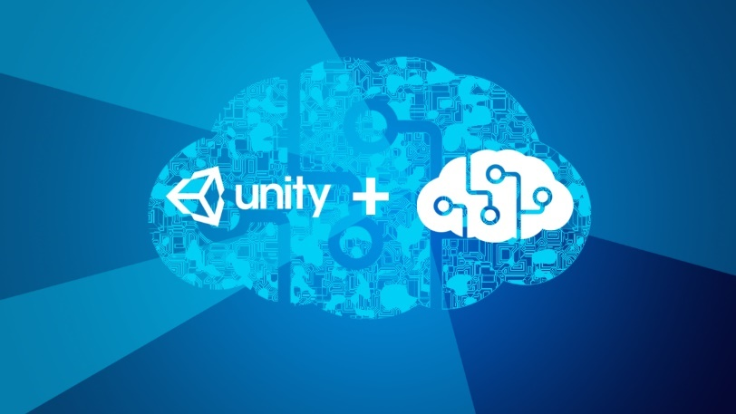
Jeff Ramos Associate Lead Consultant Magenic – SoCal (San Diego)

Slide 4


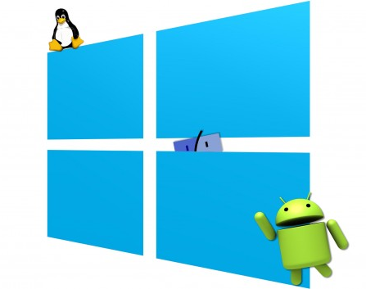
What is Azure Cognitive Services?
Artificial Intelligence Algorithms
REST APIs
Cross-Platform
Notes:
A suite of powerful Artificial Intelligence algorithms
Facilitate the creation of more engaging and personal experiences

Slide 5
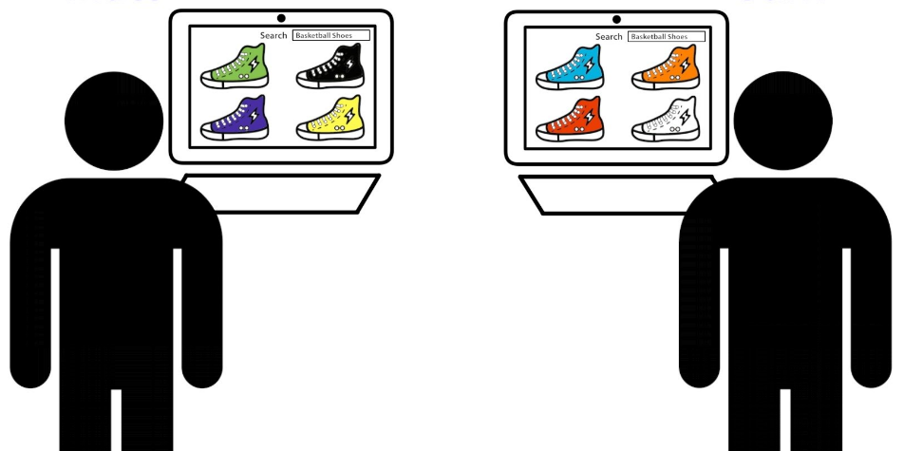
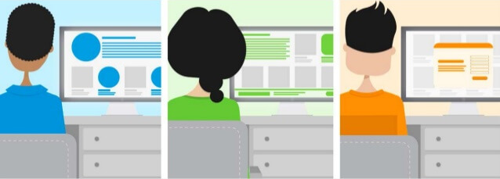

Why use Azure Cognitive Services?
User Experiences
Personalized
Engaging
Impactful
Notes:
A suite of powerful Artificial Intelligence algorithms
Facilitate the creation of more engaging and personal experiences

Slide 6

Why use Azure Cognitive Services?
Business
Competitive Advantage
Accessible
Cost-Effective
Notes:
A suite of powerful Artificial Intelligence algorithms
Facilitate the creation of more engaging and personal experiences

Slide 7
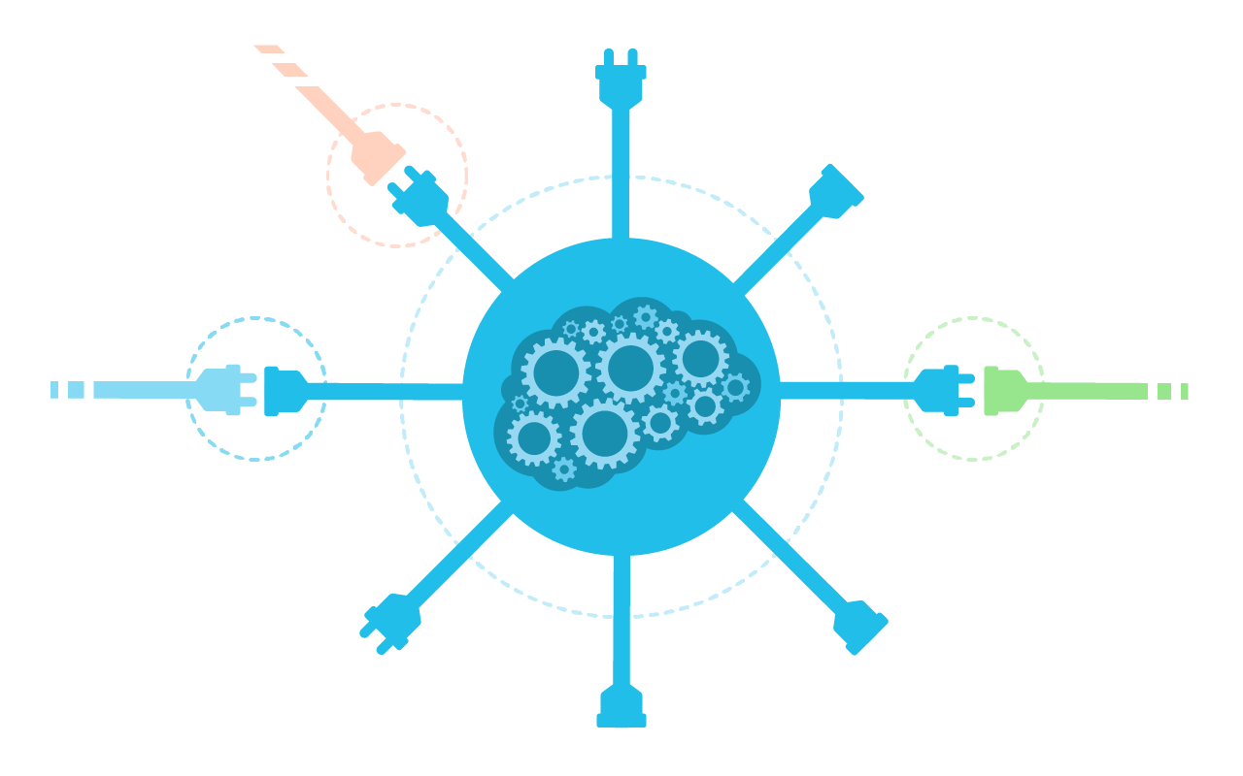
APIs

Slide 8

Vision
Computer Vision API
Emotion API
Face API
Video API

Slide 9

Speech
Bing Speech API
Speaker Recognition API
Custom Speech Service

Slide 10

Language
Bing Spell Check API
Language Understanding
Intelligent Service (LUIS)
Text Analytics API
Translator API (Speech or Text)
Notes:
LUIS – Utterance, Intents, Entities
Analytics – Sentiment, Phrases, Topics, Language

Slide 11

Knowledge
Academic Knowledge API
Recommendations API
QnA Maker API
Entity Linking Intelligence Service API
Notes:
Academic – Queries Microsoft Academic Graph (MAG) data, compiled from Bing
QnA – For bots. Turns FAQ into interactive bot
Entity Linking – Wikipedia example for linking relevant entities / topics

Slide 12

Search
Bing Search API
Web
Image
News
Video
Custom
Bing Autosuggest API

Slide 13

Pricing Model – Face API
Free
20 transactions per minute
30,000 transactions per month
No SLA
Standard
10 transactions per second
$1.50 per 1,000 transactions, up to 1M
$1.10 per 1,000 transactions, between 1M+1 and 5M
$0.65 per 1,000 transactions, between 5M+1 and 20M
99.9% uptime SLA
Face Storage
$0.50 per 1,000 images per month (up to 4 MB each)

Slide 14
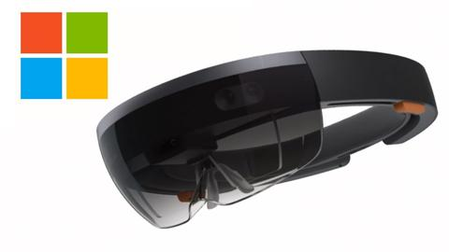


Demonstrations
REST
Unity
HoloLens

Slide 15
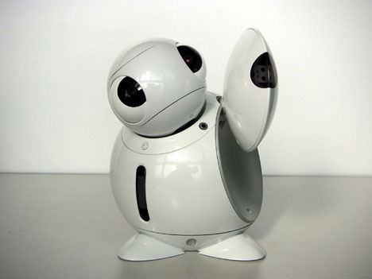
Question & Answer

Slide 16

Contact Info
Jeff Ramos
Associate Lead Consultant
Magenic – SoCal (San Diego)
949.398.3563
jeffr@magenic.com
linkedin.com/in/jeff-ramos
Thank you !

Slide 17

Resources
Cognitive Services Documentation
Online
http://aka.ms/cognitive
PDF
http://bit.ly/2tSRFSr
Future Topics
Azure AI Cloud
http://zd.net/2f50oi4
HoloLens 2.0
http://bit.ly/2wiaOhz

